Slide 1
Intro to Deep Learning
DataHacks 2020
Presenter: Victor

Slide 2
What is Deep Learning?

Slide 3
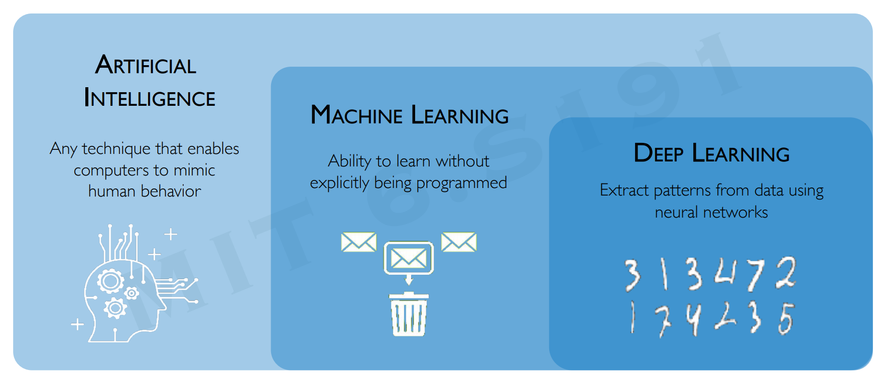
What is Deep Learning?

Slide 4
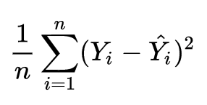
What is Deep Learning?
Just like any other ML model, we are given input X and want to predict output Y
Email Spam Detection
X = email text body
Y = {Spam, Not Spam}
Stock Price Prediction
X = series of stock prices from the last week
Y = stock price for tomorrow
Cat/Dog Image Classification
X = image (series of pixel values)
Y = {Cat, Dog}
However, the difficulty in a lot of ML problems is feature selection/extraction!

Slide 5
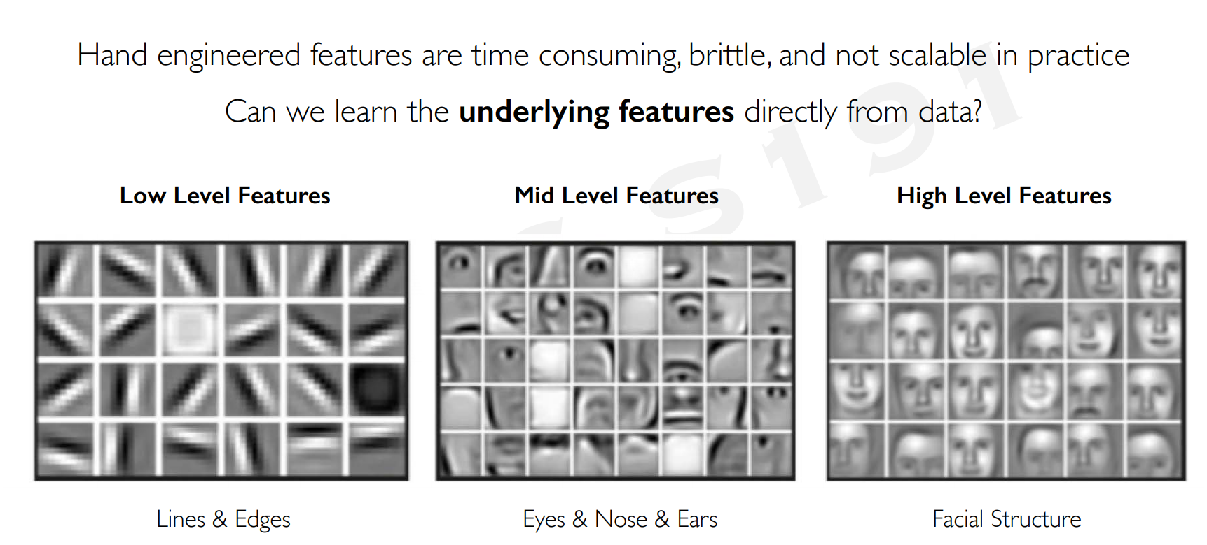
What is Deep Learning?

Slide 6
What Makes Deep Learning Special?
Machine Learning | Deep Learning
Works on small datasets | Works on large datasets
Works on low-end computers | Dependent on high-end computer
Takes less time to train | Takes more time to train
Takes more time to test | Takes less time to test

Slide 7
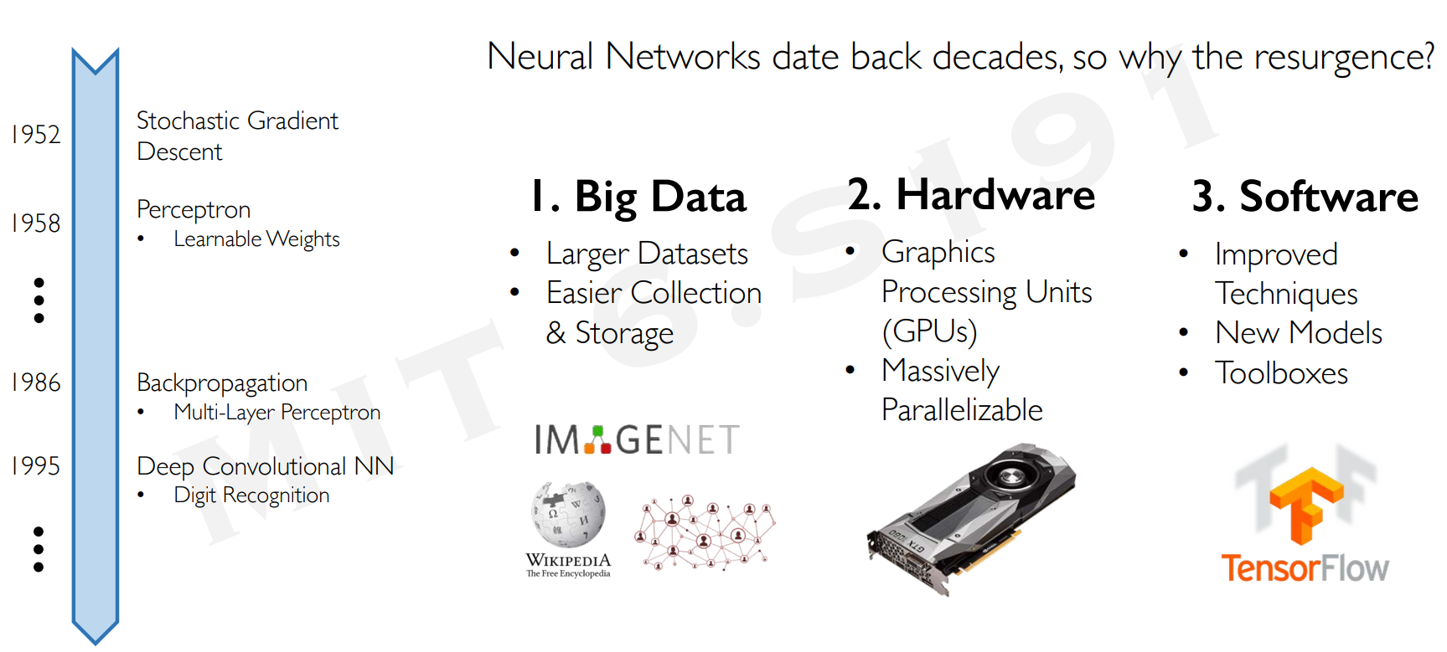
What Makes Deep Learning Special?

Slide 8
How Does Deep Learning Work?

Slide 9

How Does Deep Learning Work?

Slide 10
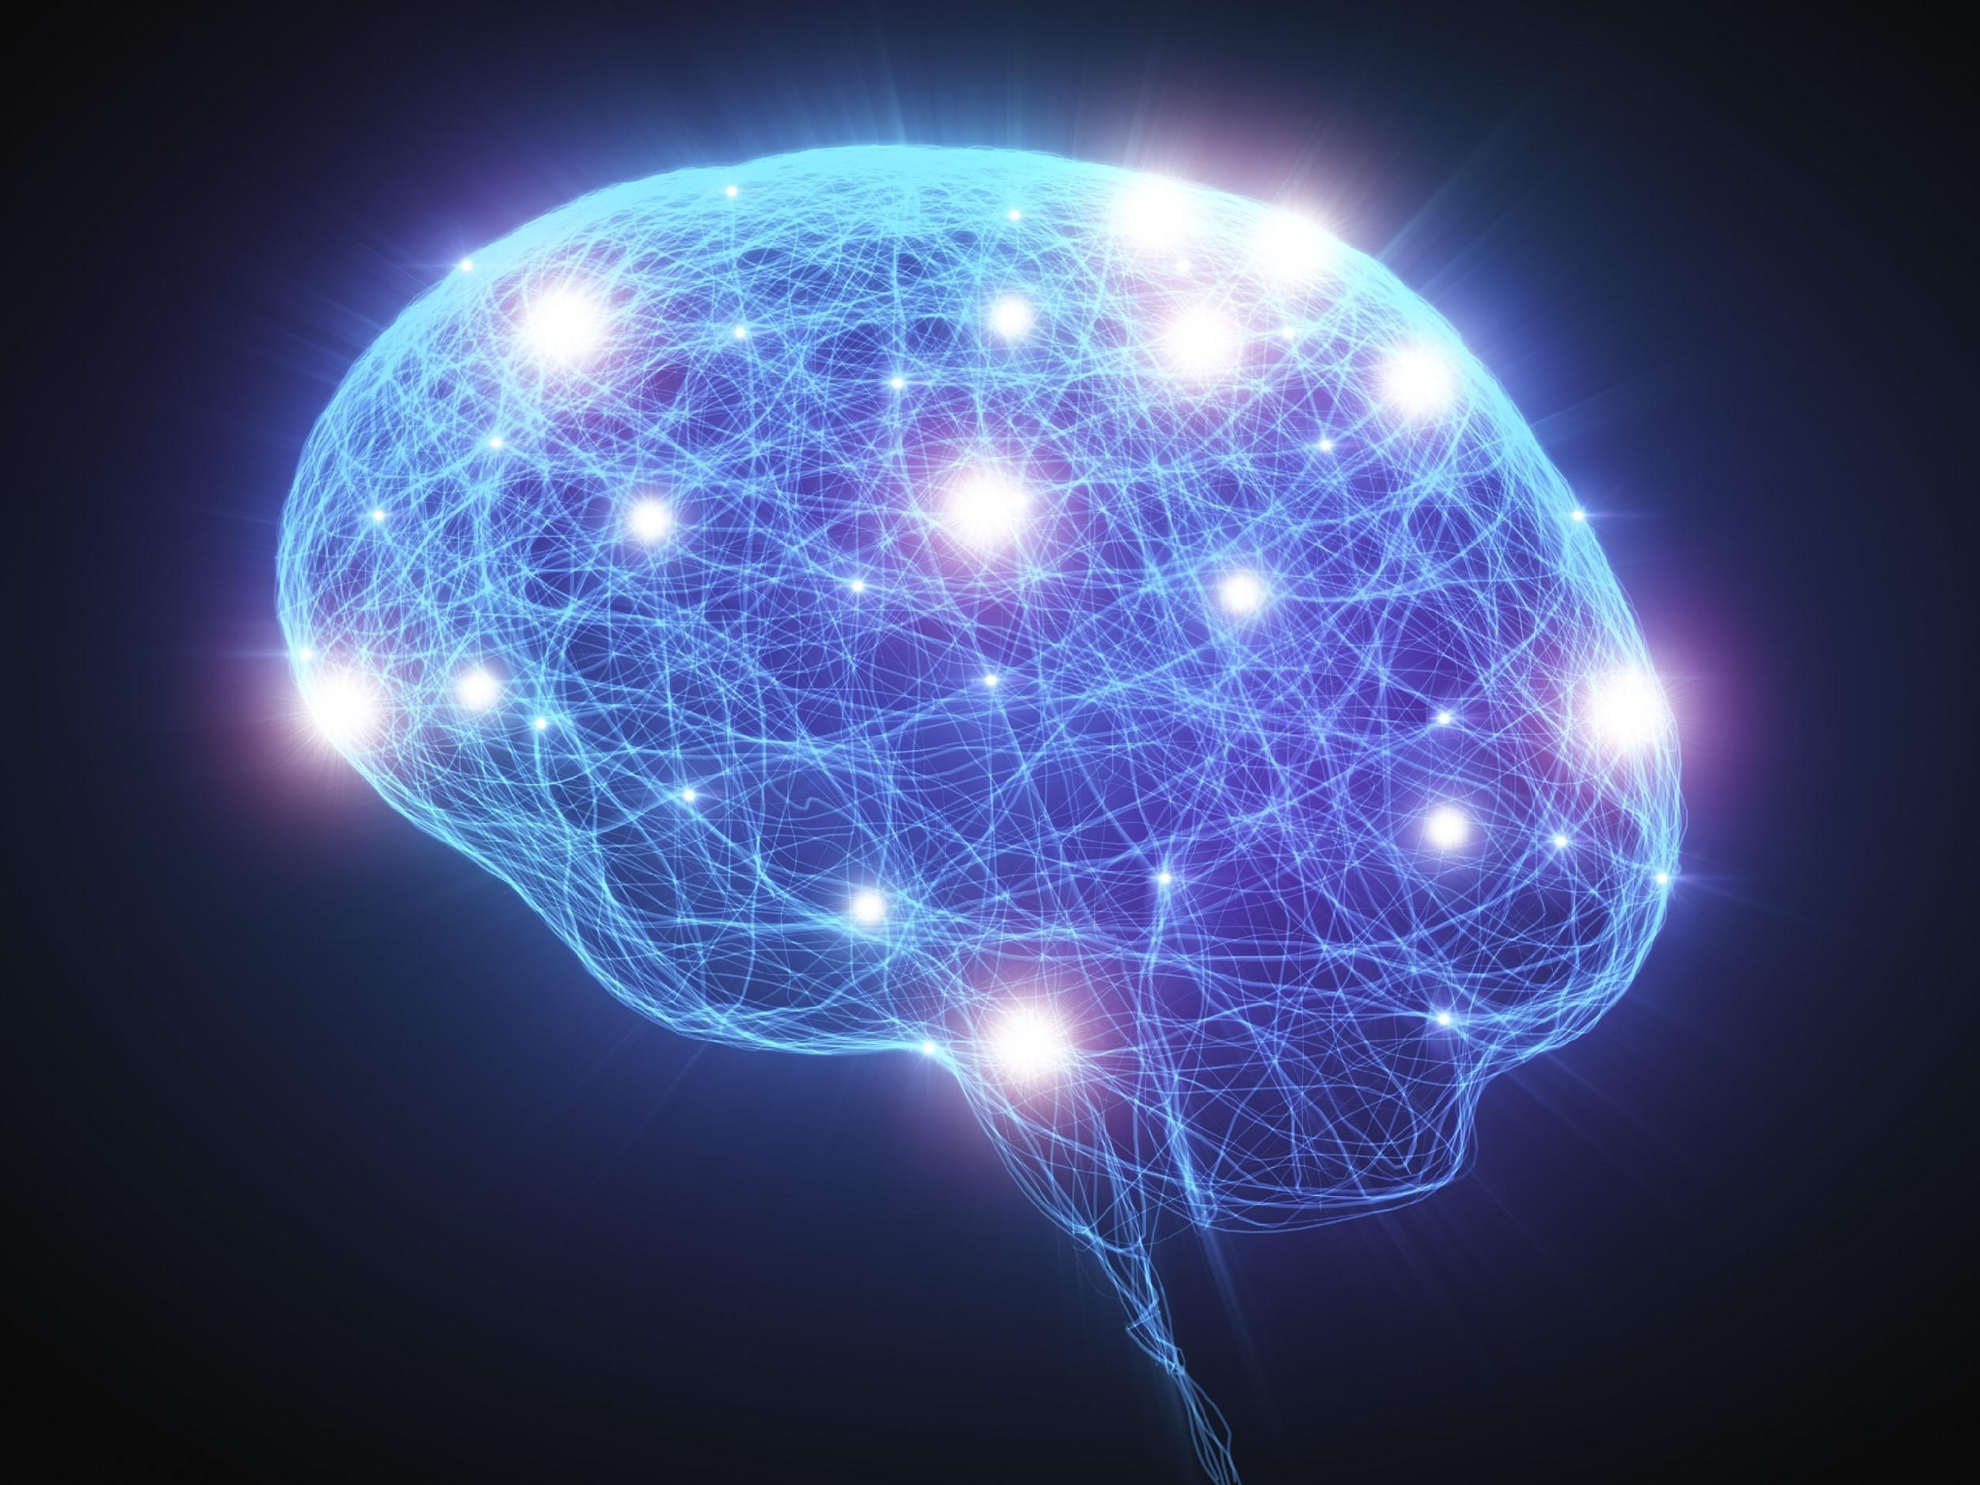
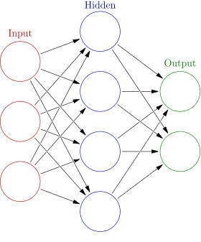
What is a Neural Network?

Slide 11
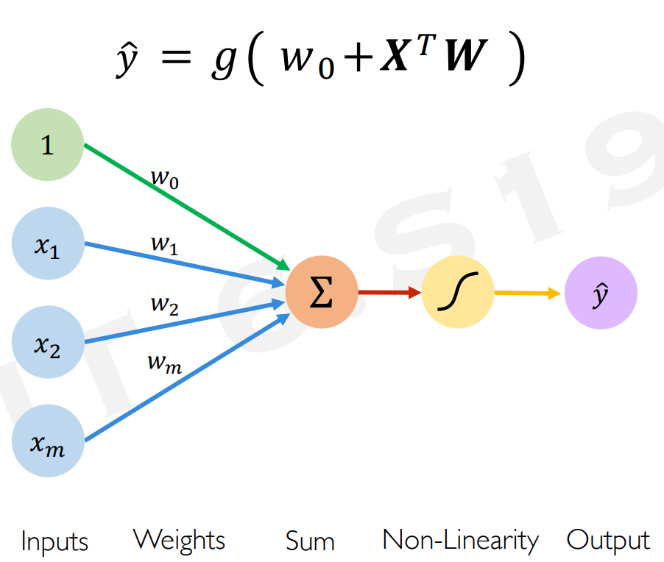

What is a Perceptron?

Slide 12
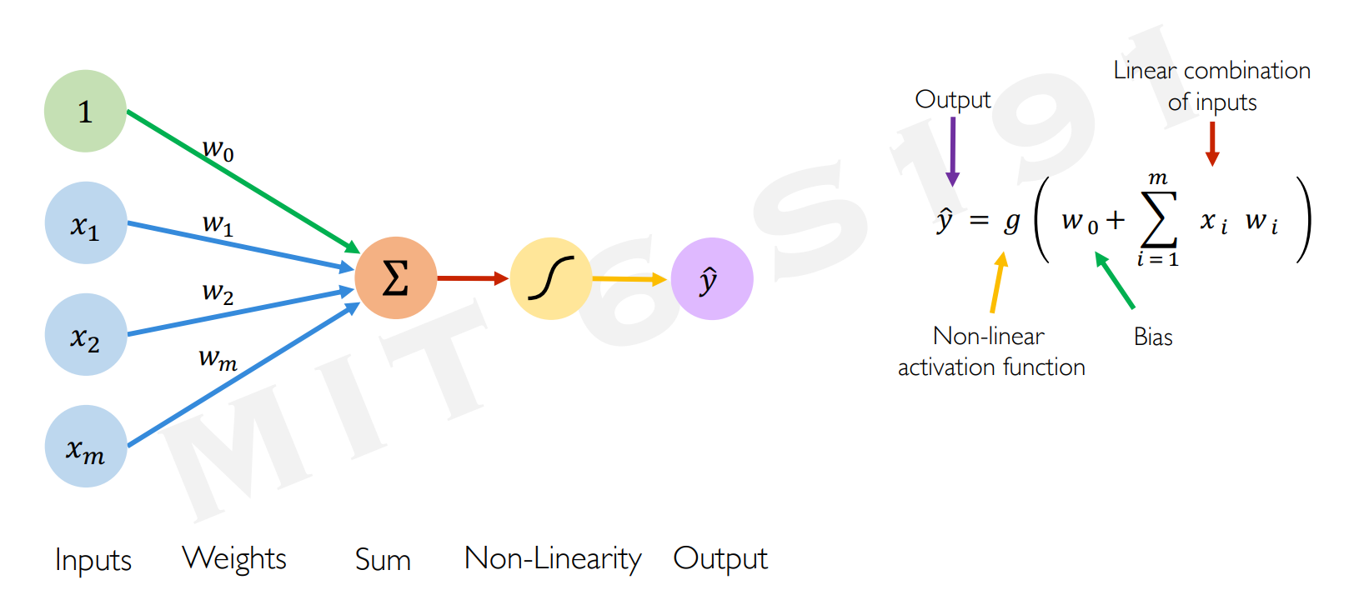
The Perceptron

Slide 13
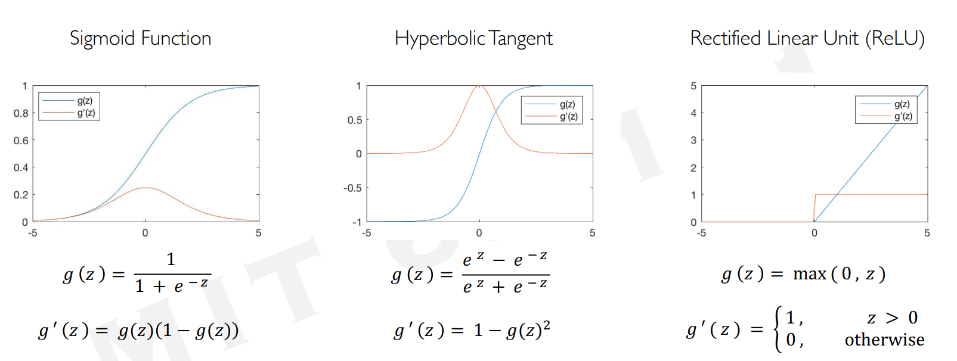
Common Activation Functions

Slide 14
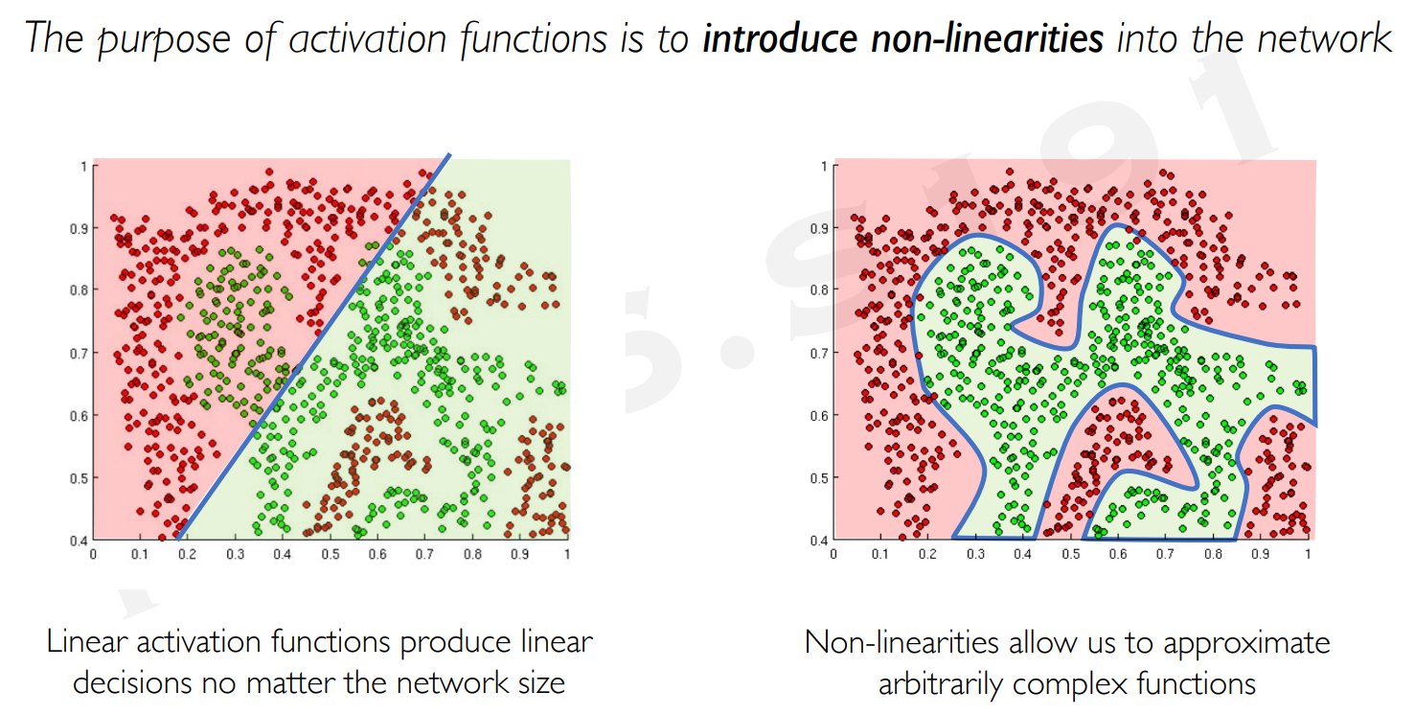
Importance of Activation Functions

Slide 15
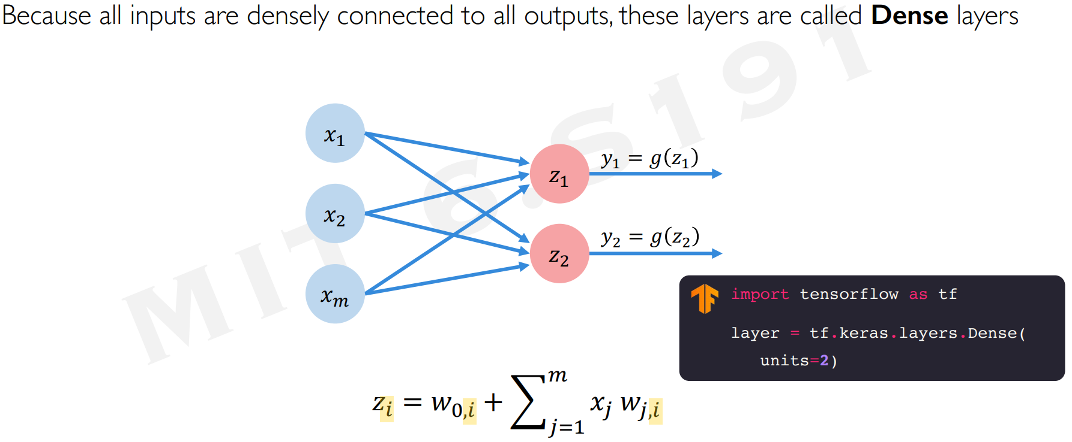
Multi-Output Perceptron

Slide 16
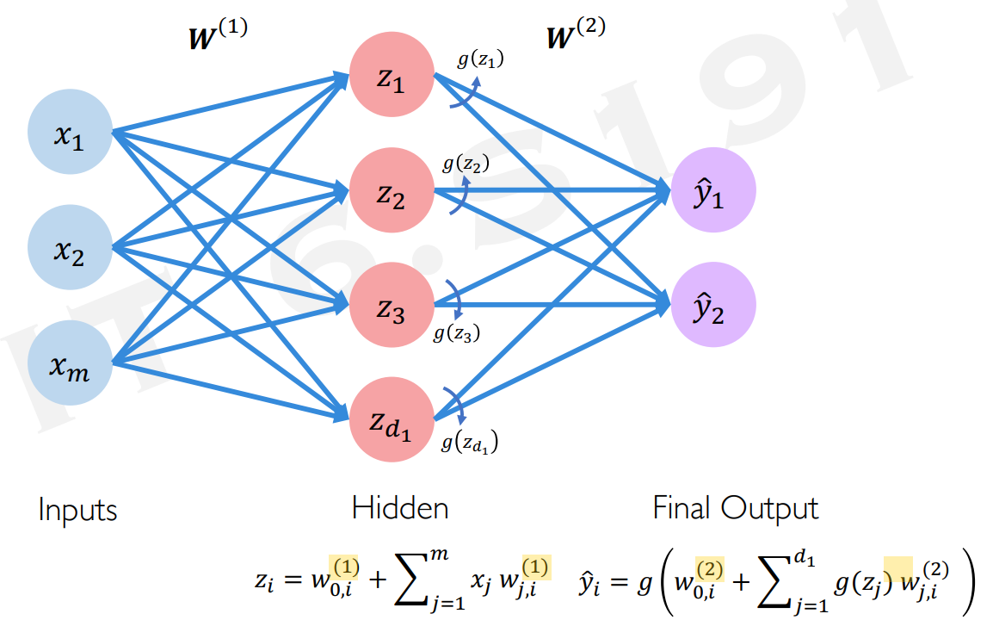
Single Layer Neural Network

Slide 17
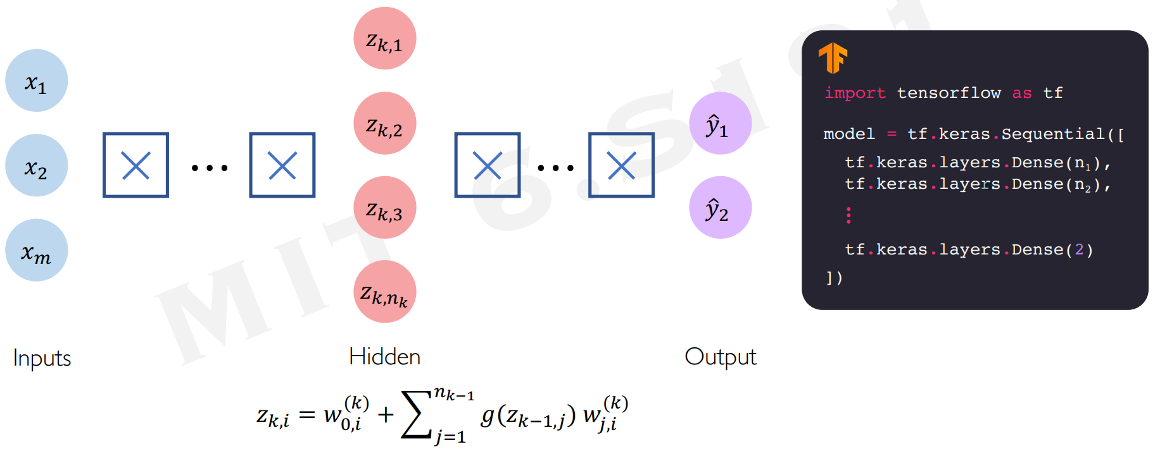
Deep Neural Networks

Slide 18
Training Neural Networks

Slide 19
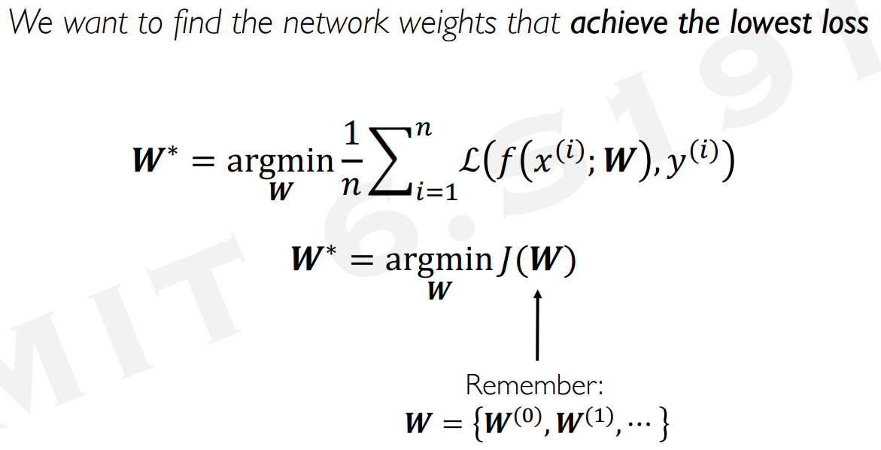
Loss Optimization

Slide 20
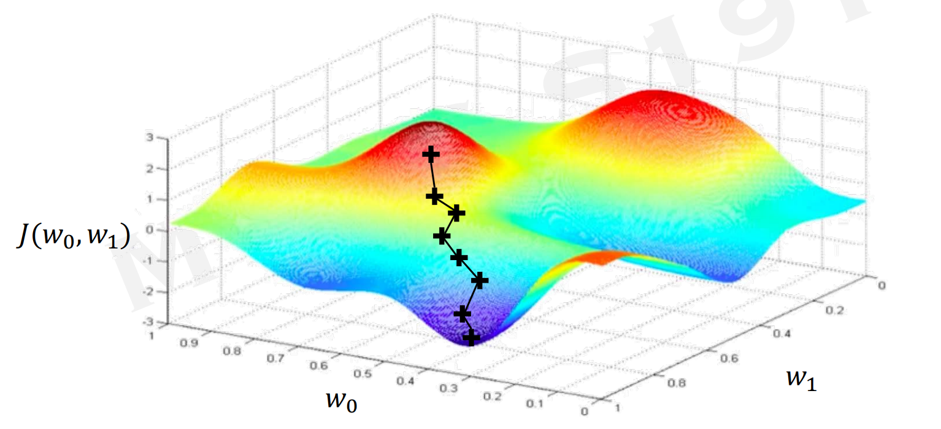
Gradient Descent

Slide 21
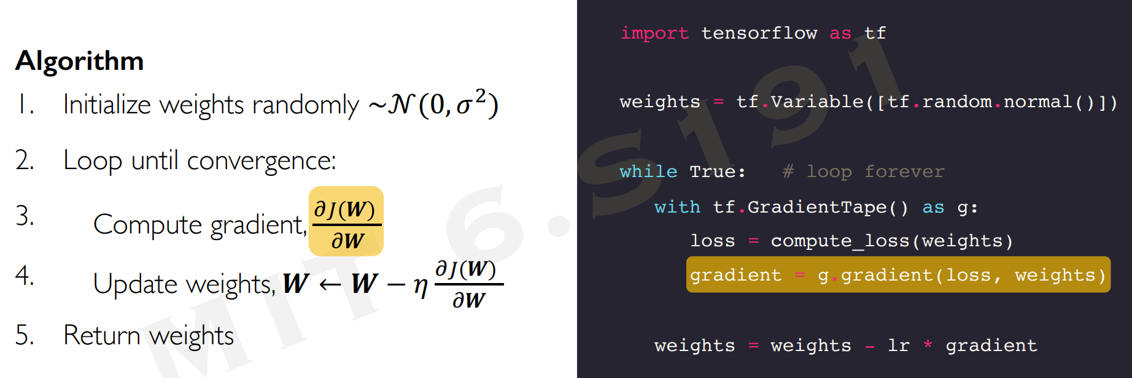
Gradient Descent

Slide 22
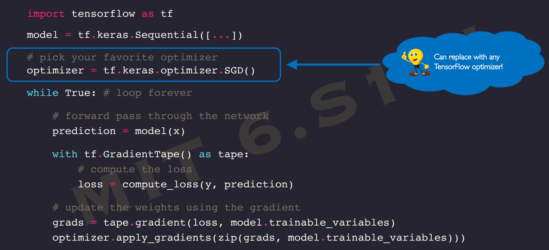
Putting It All Together

Slide 23
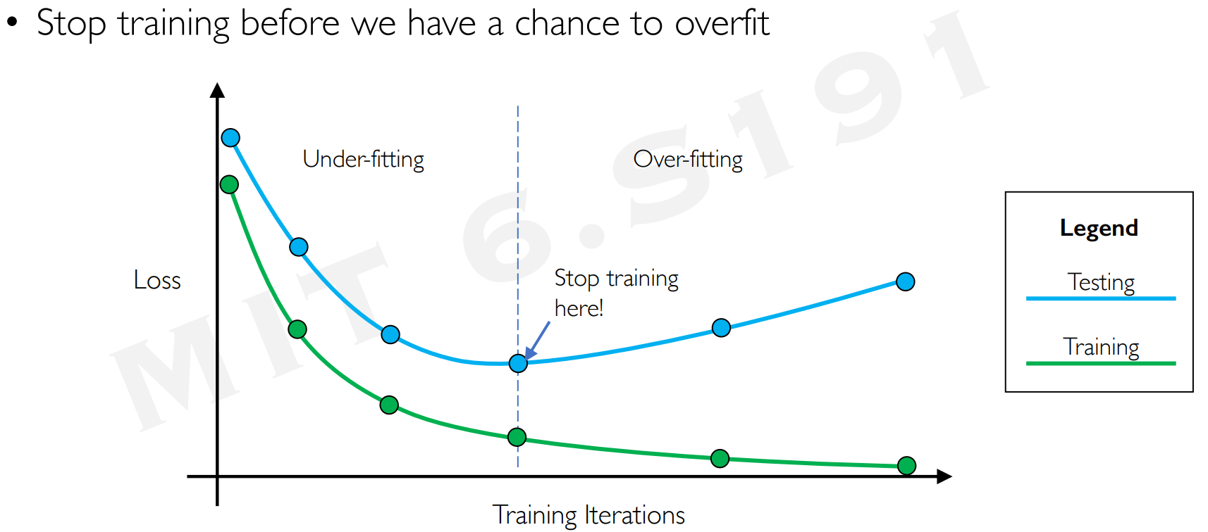
Prevent Overfitting

Slide 24
Deep Learning for NLP

Slide 25

Convolutional Neural Networks (CNNs)
Mainly used for computer vision tasks
image recognition, object detection, etc.

Slide 26
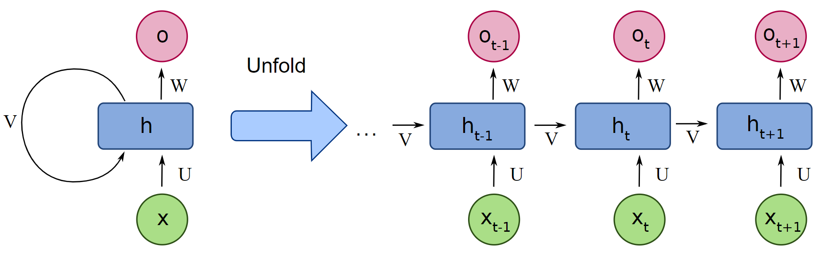
Recurrent Neural Networks (RNNs)
Mainly used for NLP
Language modeling, word embeddings, etc.

Slide 27
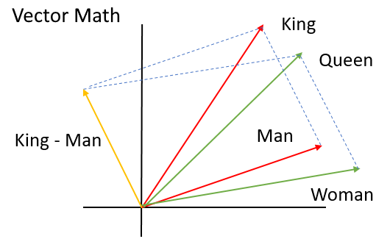
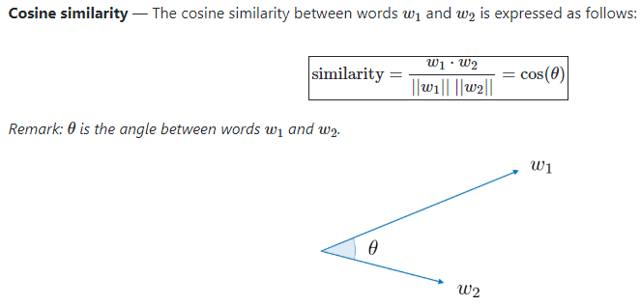
Representing Text Data
Idea: Each word is vectorized (converting text into numbers)
We take each sentence and convert it into a vector of size (number of unique words in all sentences)
The goal is to get similar sentences closer together in a high dimensional vector space

Slide 28
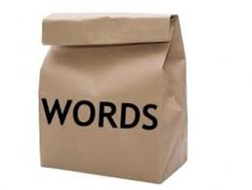
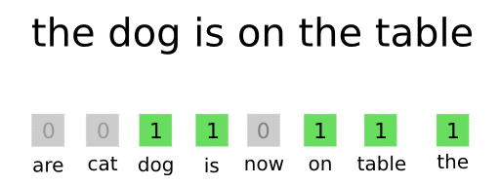
Bag of Words (BOW)
Example 1:
Dictionary = {the, cat, sat, dog, orange, apple, grape}
Sentence 1 = “The cat sat” vec1 = [1, 1, 1, 0, 0, 0, 0]
Sentence 2 = “The dog sat” vec2 = [1, 0, 1, 1, 0, 0, 0]
Sentence 3 = “Orange, apple, grape” vec3 = [0, 0, 0, 0, 1, 1, 1]
Example 2:

Slide 29
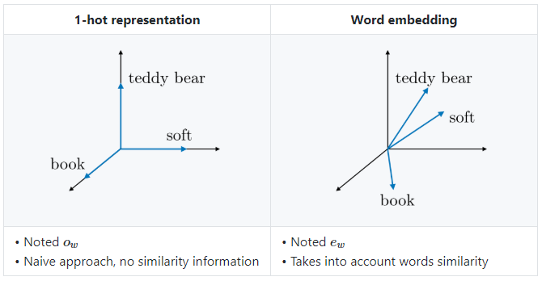
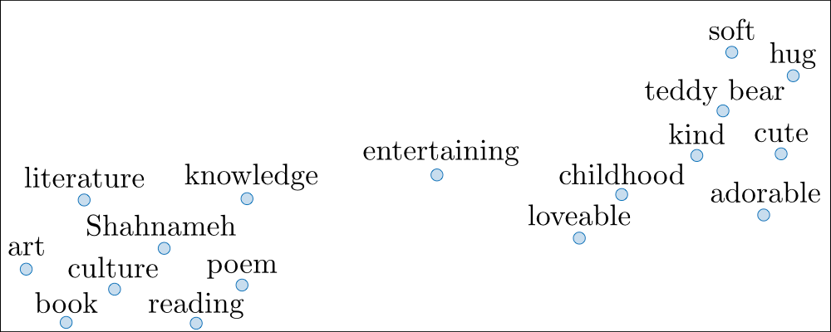
Word Embeddings

Slide 30
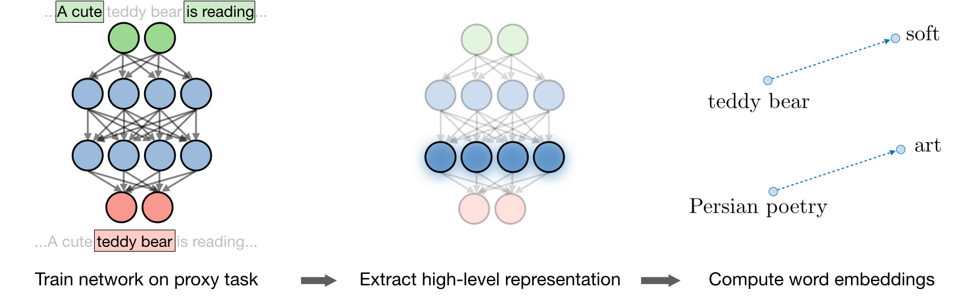
Word2Vec
Word2vec is a framework aimed at learning word embeddings by estimating the likelihood that a given word is surrounded by other words

Slide 31
Deep Learning Sources
Introduction to Deep Learning
An Introduction to Deep Learning
Introduction to Deep Learning
Neural networks and deep learning
A Beginner's Guide to Neural Networks and Deep Learning
CS 230 - Recurrent Neural Networks Cheatsheet
Recurrent Neural Networks

Slide 32
NLP Resources
Natural Language Toolkit — NLTK 3.4.5 documentation
Working With Text Data — scikit-learn 0.22.1 documentation
6.2. Feature extraction — scikit-learn 0.22.1 documentation
gensim: models.word2vec – Word2vec embeddings
A Beginner's Guide to Word2Vec and Neural Word Embeddings
Introduction to Word Embedding and Word2Vec
Word2Vec Tutorial - The Skip-Gram Model
Word2vec Tutorial

